Slide 1



UNIVERSITY INSTITUTE OF ENGINEERING
COMPUTER SCIENCE ENGINEERING
Bachelor of Engineering
Design and Analysis of Algorithms(CST-311/ITT-311)
Topic: Sum-of-subsets, Hamiltonian cycles
DISCOVER . LEARN . EMPOWER

Slide 2
Learning Objectives & Outcomes
Objective:
To understand the concept Sum-of-subsets, Hamiltonian cycles
Outcome:
Student will understand
Sum-of-subsets
Hamiltonian cycles

Slide 3
Subset-Sum Problem
The Subset-Sum Problem is to find a subset's' of the given set S = (S₁ S₂ S₃...S_{n}) where the elements of the set S are n positive integers in such a manner that s'∈S and sum of the elements of subset's' is equal to some positive integer 'X.'
The Subset-Sum Problem can be solved by using the backtracking approach. In this implicit tree is a binary tree. The root of the tree is selected in such a way that represents that no decision is yet taken on any input. We assume that the elements of the given set are arranged in increasing order:
S₁ ≤ S₂ ≤ S₃... ≤ S_{n}

Slide 4

Subset-Sum Problem (Contd.)
The left child of the root node indicated that we have to include 'S₁' from the set 'S' and the right child of the root indicates that we have to execute 'S₁'. Each node stores the total of the partial solution elements. If at any stage the sum equals to 'X' then the search is successful and terminates.
The dead end in the tree appears only when either of the two inequalities exists:
The sum of s' is too large i.e. s'+ S_{i} + 1 > X
The sum of s' is too small i.e.

Slide 5
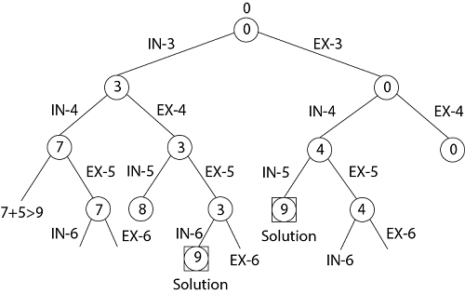
Example
Given a set S = (3, 4, 5, 6) and X =9. Obtain the subset sum using Backtracking approach.
Solution:
Initially S = (3, 4, 5, 6) and X =9.
S'= (∅)
The implicit binary tree for the subset sum problem is shown as fig:

Slide 6
Hamiltonian Circuit Problems
Given a graph G = (V, E) we have to find the Hamiltonian Circuit using Backtracking approach. We start our search from any arbitrary vertex say 'a.' This vertex 'a' becomes the root of our implicit tree. The first element of our partial solution is the first intermediate vertex of the Hamiltonian Cycle that is to be constructed.
The next adjacent vertex is selected by alphabetical order. If at any stage any arbitrary vertex makes a cycle with any vertex other than vertex 'a' then we say that dead end is reached. In this case, we backtrack one step, and again the search begins by selecting another vertex and backtrack the element from the partial; solution must be removed. The search using backtracking is successful if a Hamiltonian Cycle is obtained.

Slide 7
REFERENCES
Text books:
Cormen, Leiserson, Rivest, Stein, “Introduction to Algorithms”, Prentice Hall of India, 3rd edition 2012. problem, Graph coloring.
Websites:
https://www.javatpoint.com/subset-sum-problems
https://www.javatpoint.com/hamiltonian-circuit-problems

Slide 8
Summary
  Backtracking:
    Sum-of-subsets
    Hamiltonian cycles

Slide 9
THANK YOU

